Slide 1
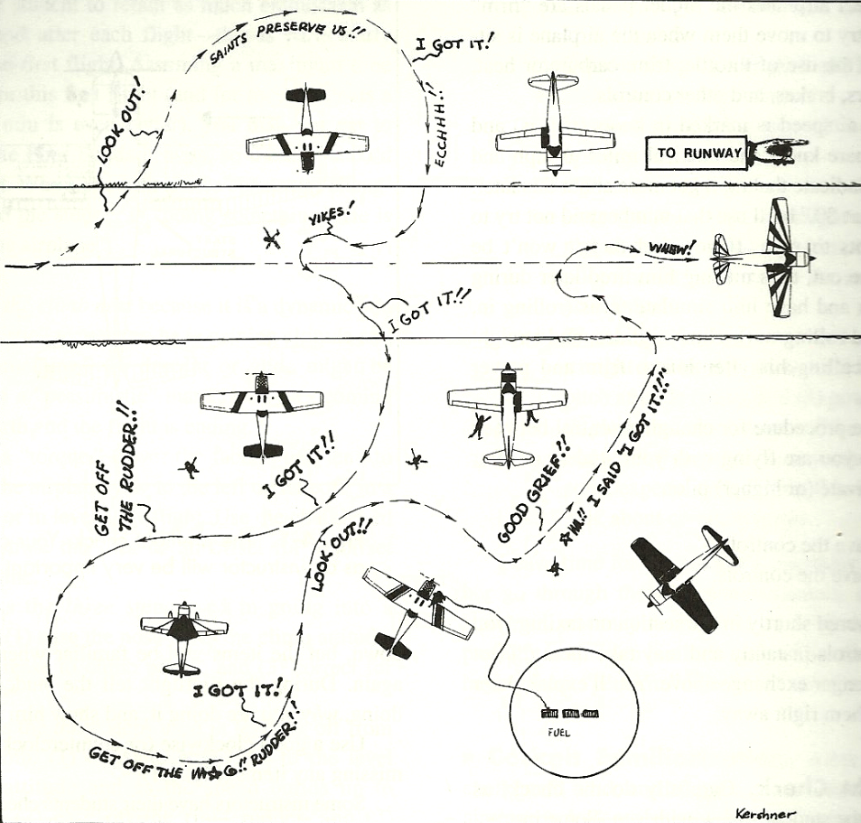
Flying in the Windy Seasons
(Or, at least how to keep the wreckage in the center of the runway)

Slide 2
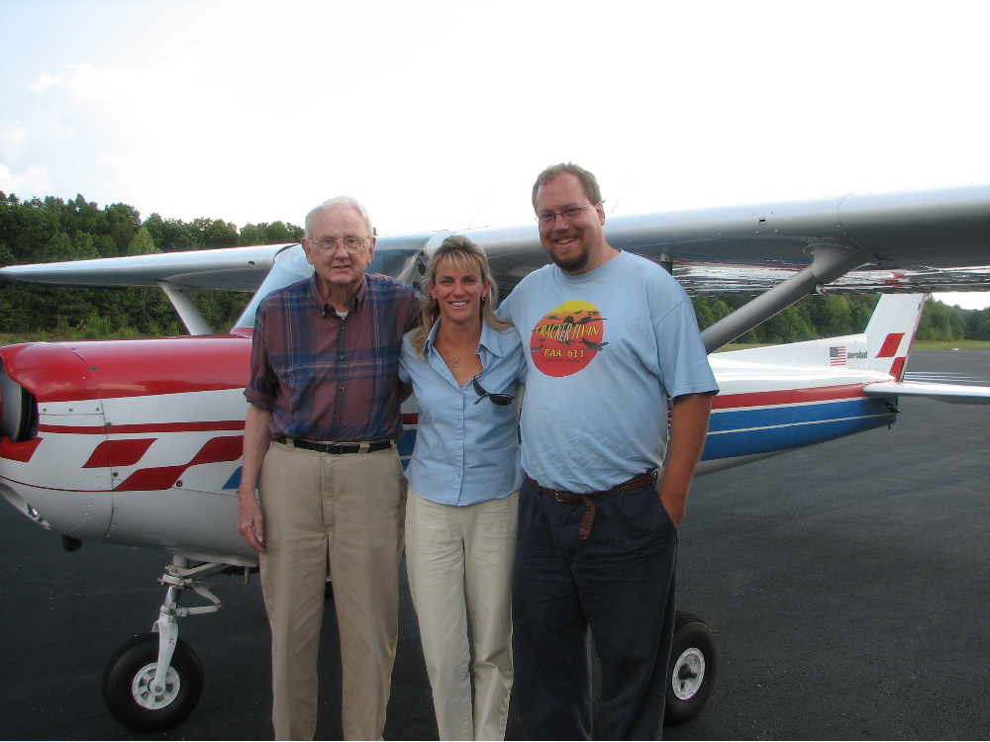
Thanks and apologies to Bill Kershner

Slide 3
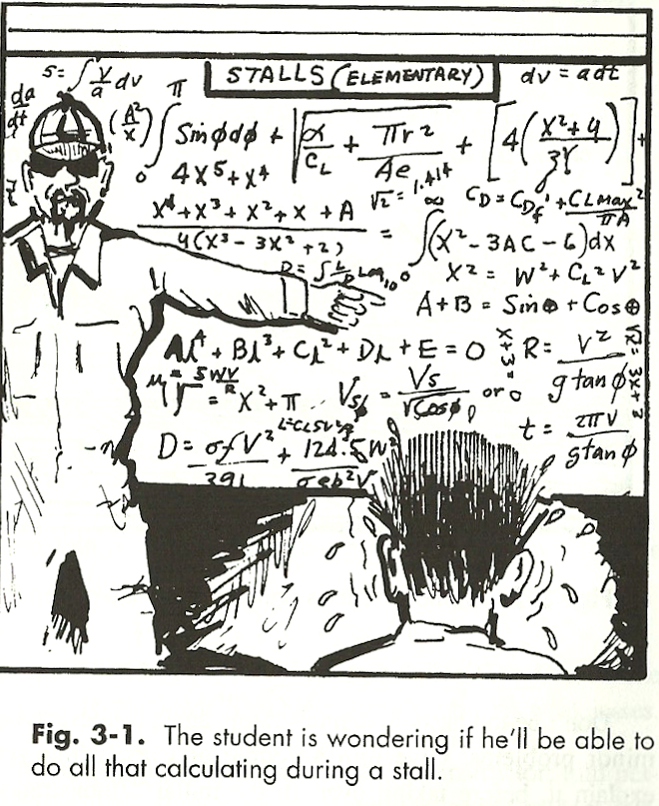
X-WIND
crosswind landing
Notes:
- Although intimidating at first, landing in a crosswind is not as difficult as it first appears!

Slide 4
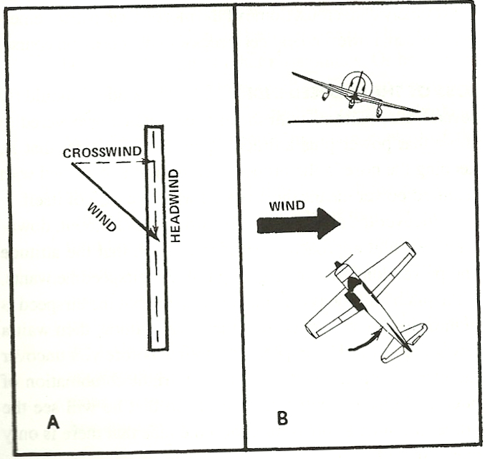
Notes:
A displays the wind conditions that are likely to be found acting on the plane.
B displays the movement tendencies of the airplane when acted upon by a crosswind.

Slide 5
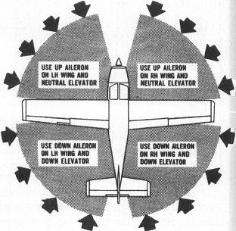
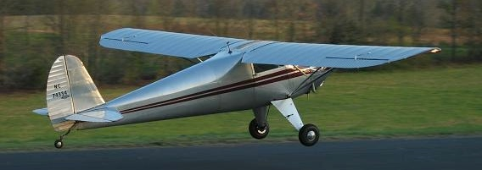
When Taxiing…
“Turn into a headwind, Dive away from a tailwind.”
Climb
(in tailwheel aircraft)
Notes:
- With a tailwheel aircraft, one should CLIMB in a headwind.

Slide 6
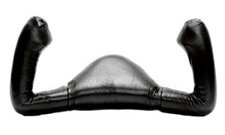
Takeoff…
Wind 290
7
25
Notes:
- On takeoff, full control lock is necessary as the control surfaces are less effective the slower the airspeed. As roll-out occurs, input can be dialed back.

Slide 7
In the Pattern …
Wind 290
7
25
Notes:
- As a pilot, we should strive to maintain the pattern in GREEN.

Slide 8
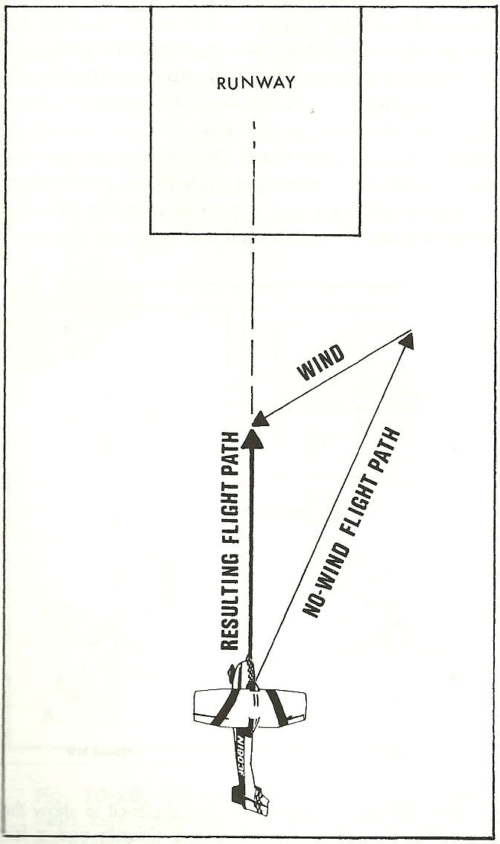
On Final…

Slide 9
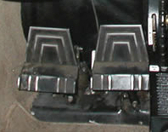
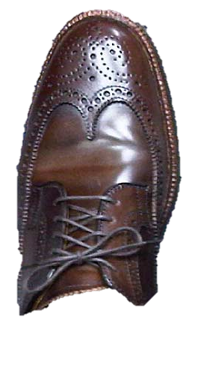
On Final…
MAINTAIN AIRSPEED ALL THE WAY TO THE RUNWAY
Wind 290
(+50% of gust factor?)
Wing down into the wind
to align with the runway
Opposite rudder to straighten
Longitudinal axis of airplane

Slide 10
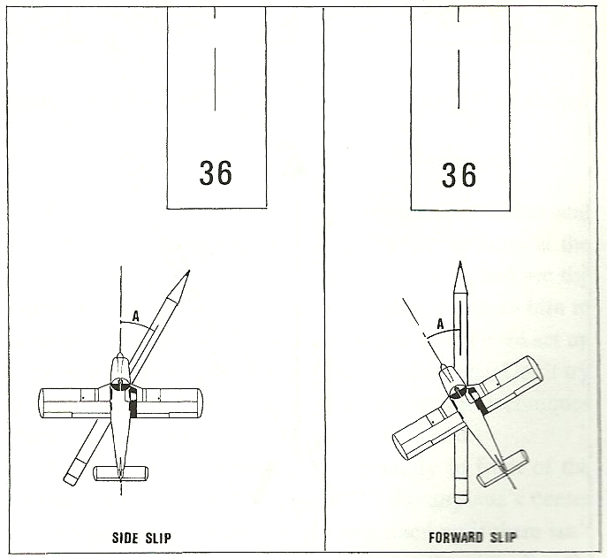
Notes:
- Side Slips and Forward Slips differ on their INTENT.

Slide 11
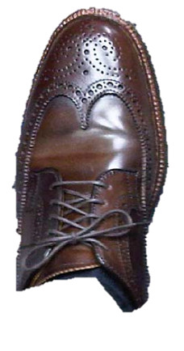
On the runway…
Control surfaces become LESS EFFECTIVE
as the airspeed decreases…
Remember!!
So, control inputs generally need to INCREASE
as the aircraft slows*

Slide 12
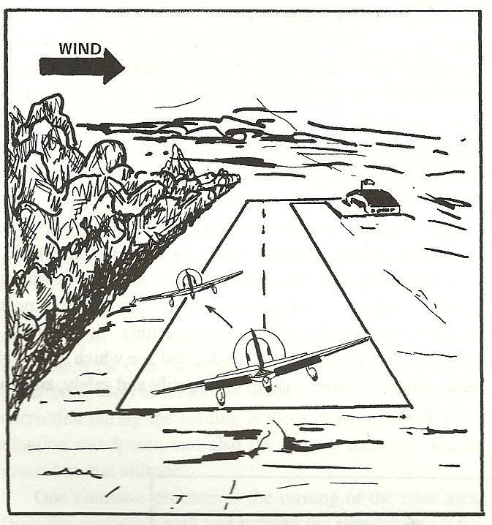
… BUT: terrain, trees, etc, usually make it more interesting
Notes:
- The illustration is a good visual of what occurs often at KCEU. As the aircraft descends below the level of the treetops, the effect of the wind will drastically reduce. Due to this, the pilot needs to be anticipating that change to prevent the aircraft from diving to toward the direction of the wind.

Slide 13
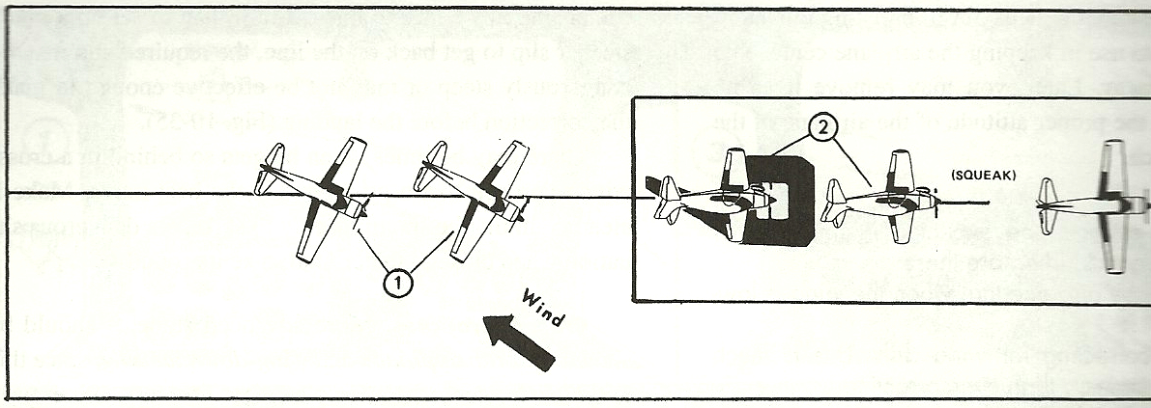
Crabbing approach with straightening at end
(meh)

Slide 14
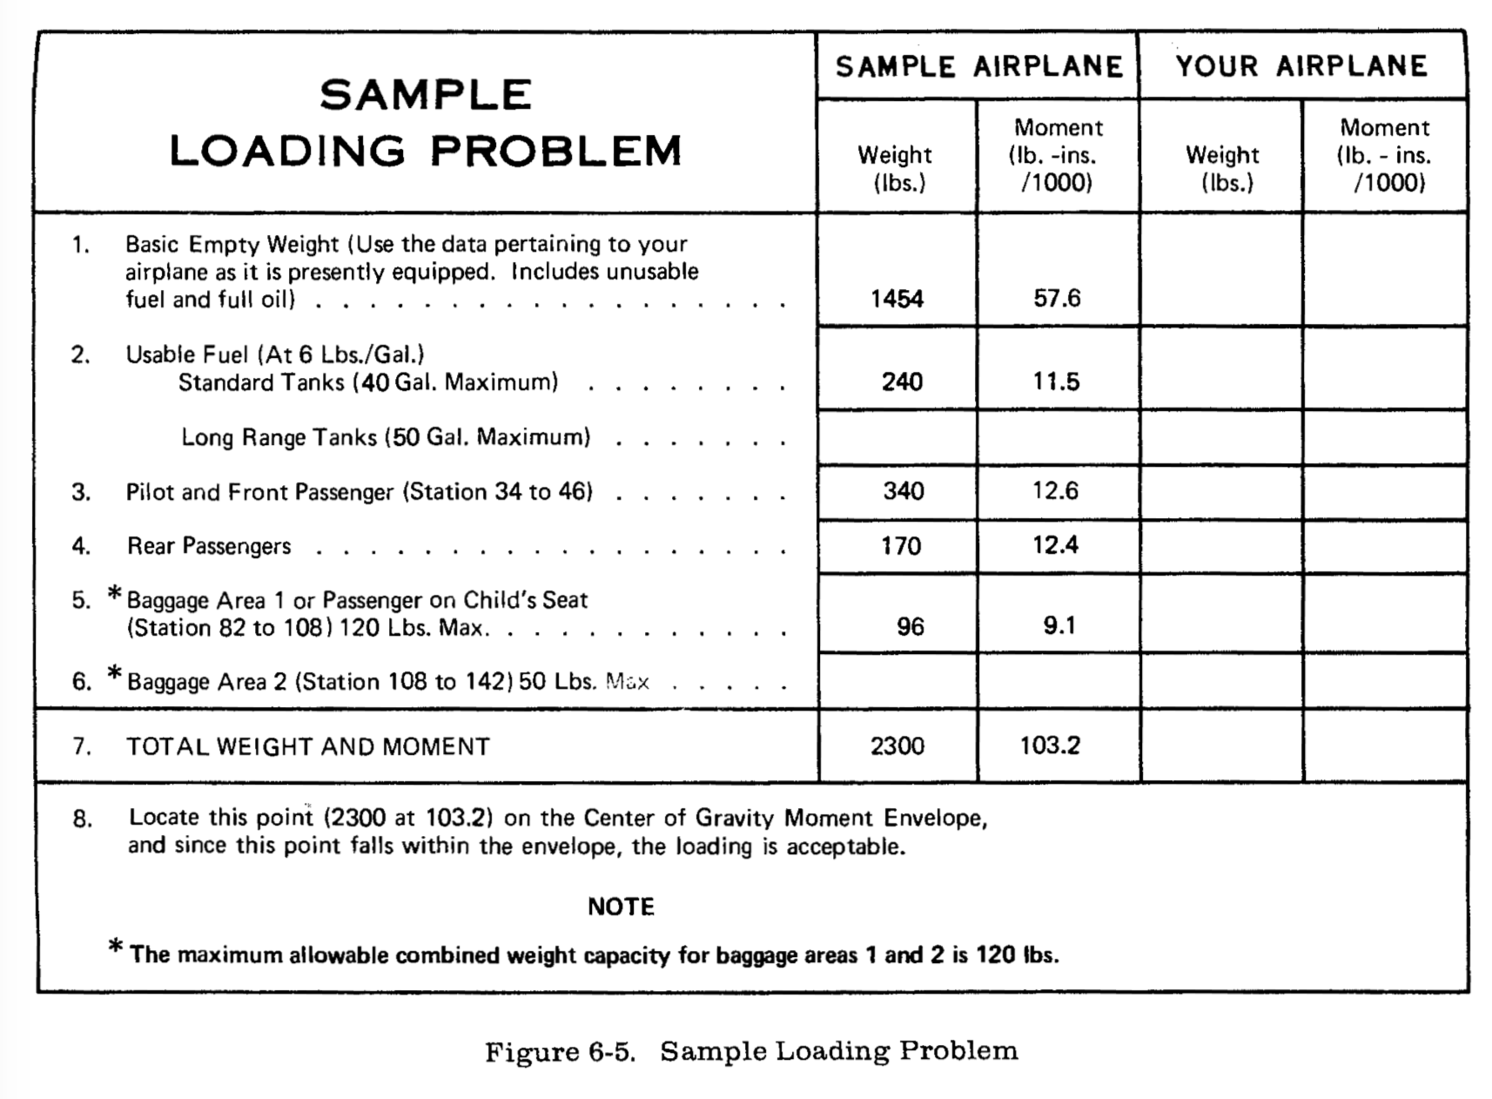
1454
57.6
240
11.5
400
15
200
17
2294
101.1

Slide 15
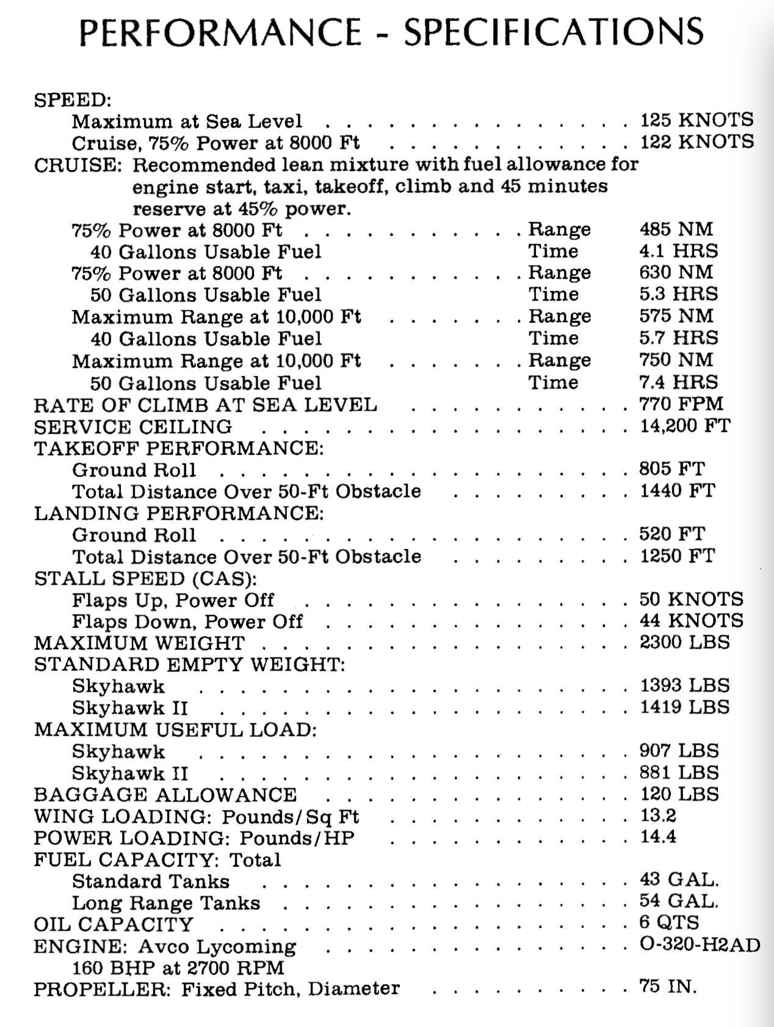

Slide 16
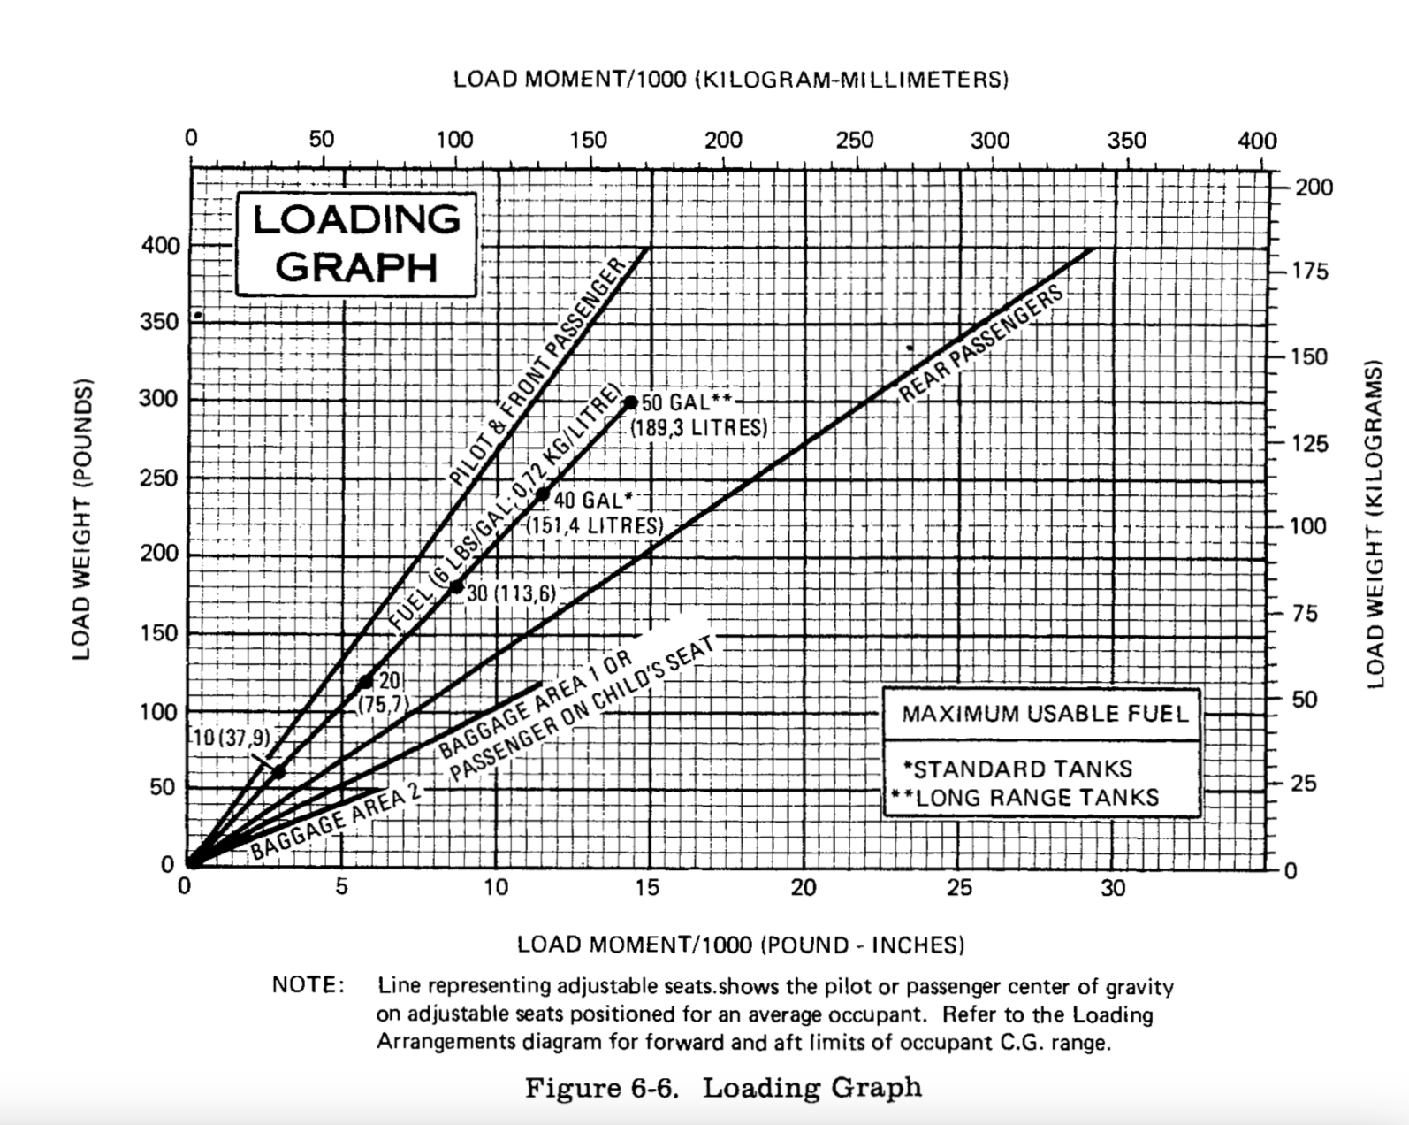

Slide 17
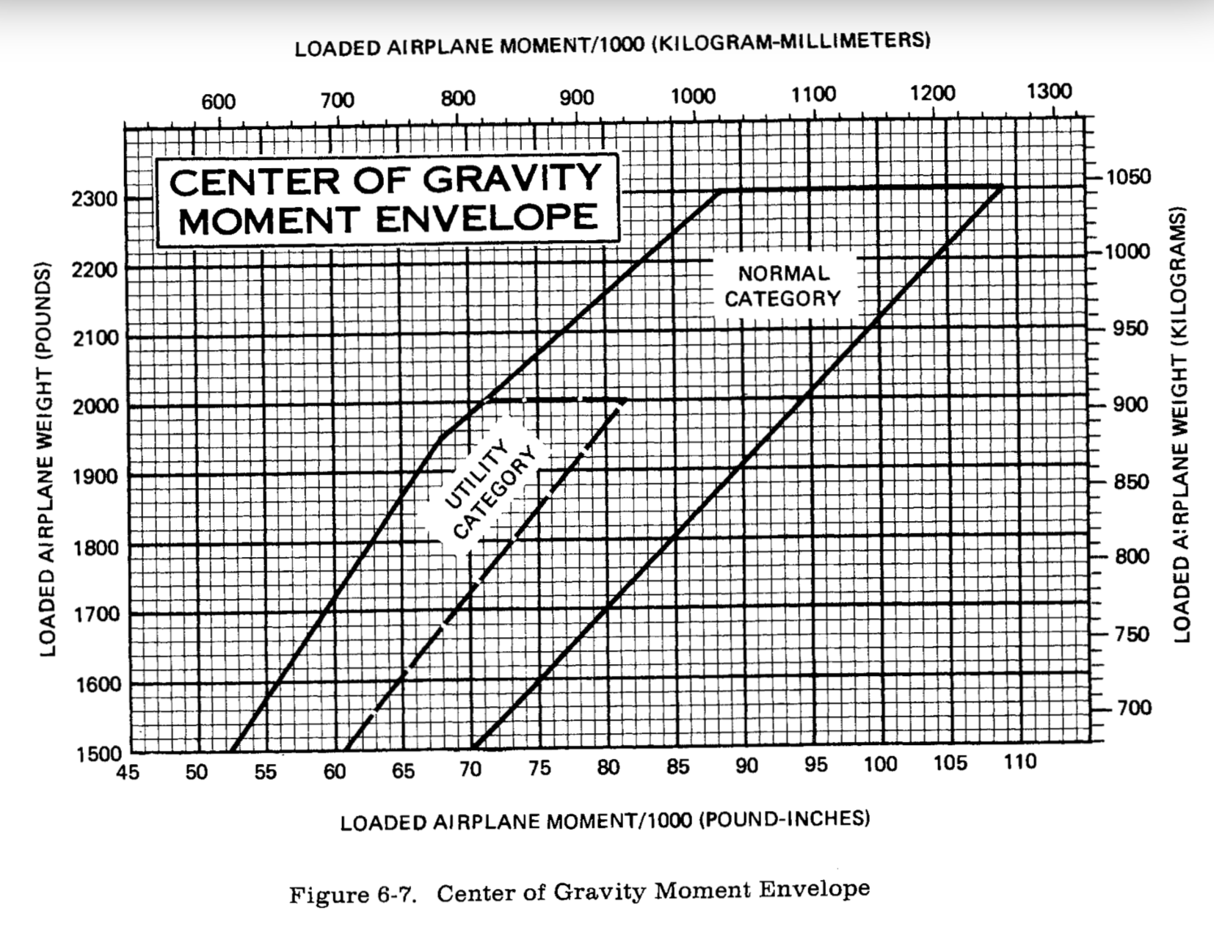

Slide 18
